Slide 1
INSTAGRAM USER ANALYTICS
SUBMITTED BY :
ANISH KATOCH

Slide 2
PROJECT DESCRIPTION
This project is about analyzing the Instagram users data.
I have to find out the engagement of users in Instagram and detecting the inactive and the fake account users. I have to analyze the data and make recommendation so to indulge users to use Instagram daily and help Instagram to grow further in terms of popularity and other things and make their brand value strongest and safest place in the market. To help them to make more money and increase their brand value by promoting other brands and launch ad campaign.
I handle it by deleting the fake accounts and will remind the inactive users by sending them email and requested them to participate in contest and will organize more and more contest with amazing prizes so that people get entertain and use their Instagram daily. We will promote brand post by using trending hashtags and launch ad campaign on that day when users participation is highly active. It will help to reach out the ad to maximum people in minimum time. It helps brand as well as platform to grow further and make unbreakable records.

Slide 3
APPROACH
Firstly I make a database on MySQL and then create tables and insert all the values into the tables. After that I analyze each and every table meticulously and analyze in which table what value is stored and what the table is about and simultaneously saw where the foreign key is used or not and similarly for primary key. In other words which parent table is connected to which child table and vice-versa. So, that I can join the tables wherever is necessary and the memory will be less used and compilation will be faster. After that I read each and every task to be performed and write query using MySQL commands according to the given task.

Slide 4
TECK STACK
I have used MySQL Workbench and the version is 8.0.32.
MySQL is one of the most popular database management system where we can collect, stored and organized the data in structured way. It is user friendly and good for application that totally rely on multi-row transaction.
It provides flexibility and scalability, data protection, open source and compatible, fast and reliable and for analysis it is one of the best software.

Slide 5
INSIGHTS
First of all it makes my concept very cleared and I learned some other commands like date format which I am not aware of and know about some other things which can be used to analyze the data more accurately.
By analyzing the data I can know about the number of people which are active and inactive in Instagram and how to detect the users having fake accounts and how much user engagement is there in Instagram and how can we increase their engagement.
Instagram uses data to know how they can engage users to keep using Instagram daily.
They are earning more money by launching ad campaign and keep making unbreakable records by using trending hashtag and launching video to keep themselves ahead in social networking side so that more people get to know about Instagram and make Instagram one of their entertainment platform.

Slide 6
To active the users which are inactive we can send the mail and make them aware of contest which are currently going where they can win amazing prizes. By organizing contest every week Instagram can get more participation from users and users get entertain while using Instagram and it will make them their interest to keep using it and have their engagement in Instagram daily.
To avoid duplicity in the accounts we can detect and delete the fake accounts and make our platform safe. Instagram can make more money and more popular by using the trending hashtags to reach out the maximum people as much as they can so that each and every person get to know about the Instagram and make Instagram one of their entertainment platform.
Popularity helps Instagram to make their brand value higher and make strongest place in social media due to which more brand will approach them and it will help them to make more and more money in future as well. Instagram can aware more things about themselves by launching a video on a particular day in which most people are highly active.
Instagram can eliminate the communication gap between them and upcoming generation by analyzing the data and provide things according to the needs of the generation.

Slide 7
RESULT
The project has helped me a lot like how to analyze and optimize the data and make our data in well organized manner and also learn some new term which helped me to solve the problems.
How the data correlate with the real life and how can we improvised the things by just looking into the data and make it more customize in terms of user friendly and make it attractive for users.
It has helped me to get to know about how a data analyst person works in real life and impoverished the things by just looking into the data and provides content according to the users choice and make a platform safe from malicious activities and fake users.

Slide 8
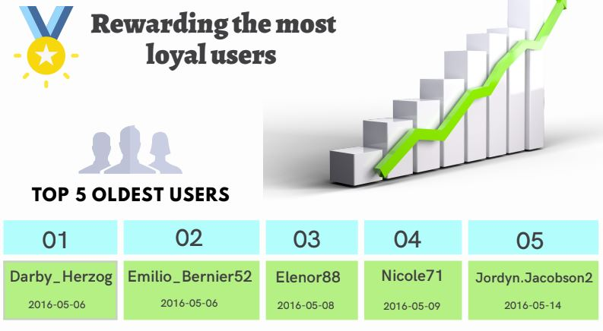
Rewarding Most Loyal Users

Slide 9
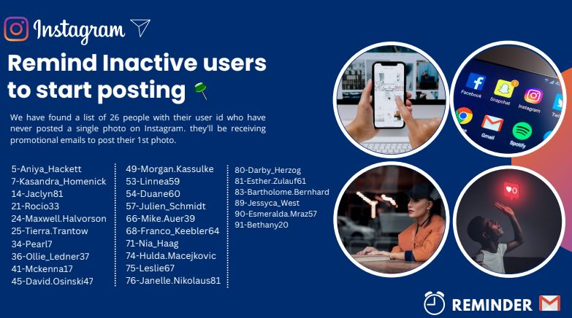
Remind Inactive Users To Start Posting

Slide 10
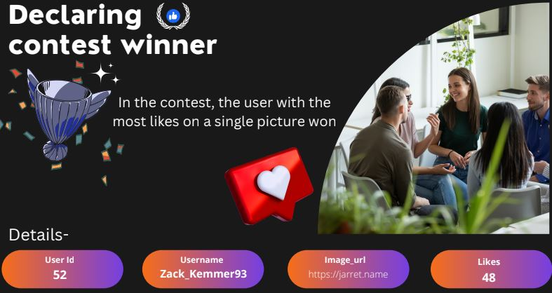
Declaring Contest Winner

Slide 11
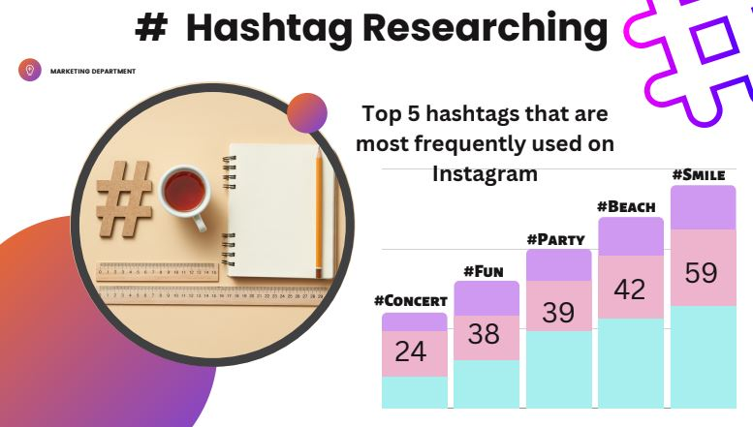
Hashtag Researching

Slide 12
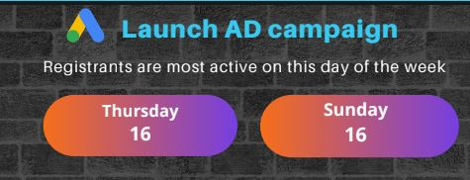
Launch Ad Campaign
THURSDAY is the day when the most users register on Instagram.
Ad campaign should be scheduled at 6:30 pm because this is the time when most of the people done with their office hours and get engage with activities like using social media, watching movie, going for market etc.

Slide 13
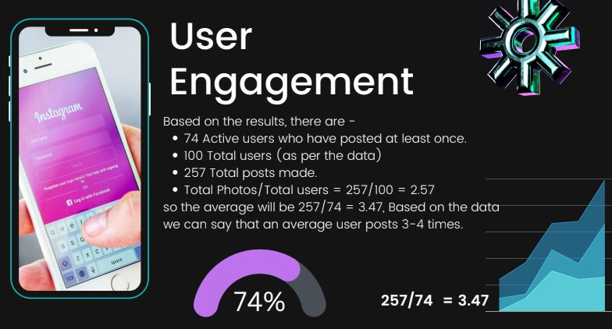
User Engagement

Slide 14
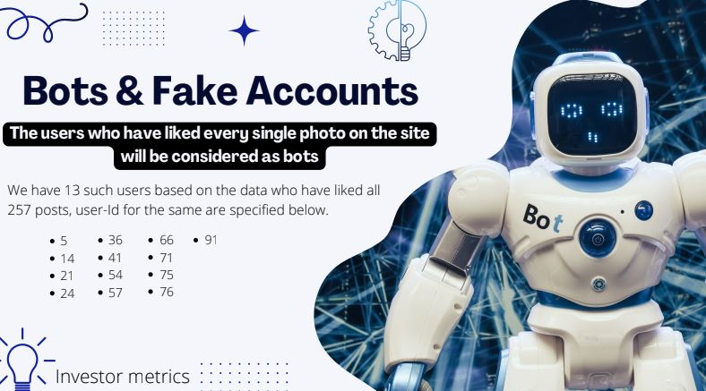
Bot And Fake Accounts

Slide 15
THANK YOU

